Slide 1
XAI
(Explainable AI)

Slide 2
Data (Two class classification)
AAC_A | AAC_C | AAC_D | AAC_E | AAC_F | AAC_G | AAC_H | AAC_I | AAC_K | AAC_L | AAC_M | AAC_N | AAC_P | AAC_Q | AAC_R | AAC_S | AAC_T | AAC_V | AAC_W | AAC_Y
10.34 | 0 | 3.45 | 0 | 10.34 | 6.9 | 0 | 3.45 | 0 | 13.79 | 6.9 | 0 | 0 | 0 | 3.45 | 13.79 | 3.45 | 17.24 | 6.9 | 0
0 | 0 | 0 | 0 | 9.09 | 0 | 0 | 0 | 0 | 18.18 | 0 | 18.18 | 9.09 | 9.09 | 27.27 | 9.09 | 0 | 0 | 0 | 0
22.22 | 0 | 11.11 | 0 | 0 | 11.11 | 0 | 0 | 11.11 | 0 | 0 | 22.22 | 0 | 0 | 11.11 | 0 | 0 | 11.11 | 0 | 0
0 | 25.81 | 0 | 6.45 | 3.23 | 3.23 | 3.23 | 3.23 | 6.45 | 3.23 | 0 | 0 | 3.23 | 3.23 | 16.13 | 12.9 | 0 | 3.23 | 3.23 | 3.23
0 | 17.14 | 2.86 | 5.71 | 2.86 | 8.57 | 2.86 | 2.86 | 11.43 | 5.71 | 0 | 8.57 | 2.86 | 2.86 | 5.71 | 11.43 | 0 | 2.86 | 2.86 | 2.86
3.23 | 19.35 | 3.23 | 3.23 | 3.23 | 9.68 | 3.23 | 3.23 | 9.68 | 16.13 | 3.23 | 3.23 | 0 | 3.23 | 6.45 | 6.45 | 0 | 3.23 | 0 | 0
10.71 | 3.57 | 3.57 | 0 | 3.57 | 14.29 | 3.57 | 0 | 0 | 7.14 | 0 | 7.14 | 0 | 3.57 | 7.14 | 10.71 | 7.14 | 10.71 | 3.57 | 3.57
3.57 | 14.29 | 7.14 | 0 | 0 | 3.57 | 0 | 3.57 | 0 | 0 | 0 | 0 | 3.57 | 0 | 32.14 | 10.71 | 7.14 | 3.57 | 0 | 10.71
6.25 | 37.5 | 0 | 6.25 | 0 | 6.25 | 0 | 0 | 0 | 0 | 6.25 | 6.25 | 12.5 | 0 | 0 | 0 | 0 | 6.25 | 0 | 12.5
5.88 | 23.53 | 5.88 | 5.88 | 0 | 5.88 | 5.88 | 5.88 | 0 | 5.88 | 0 | 5.88 | 17.65 | 0 | 0 | 5.88 | 5.88 | 0 | 0 | 0
label
0
0
0
1
1
1
0
1
1
1

Slide 3
Individual Feature Performance using Different models (Accuracy on validation dataset)
Feature | AdaBoost | BaggingClassifier | BernoulliNB | DT | ET | GNB | GB | LinearDiscriminantAnalysis | LinearSVC | LR | MLPC | NuSVC | QuadraticDiscriminantAnalysis | RF | SGDC | SVC | XGBC
AAC_A | 57.020 | 57.111 | 54.710 | 56.884 | 56.884 | 56.476 | 56.748 | 57.382 | 57.382 | 57.382 | 56.386 | 53.261 | 56.476 | 57.201 | 50.091 | 56.612 | 57.246
AAC_C | 80.118 | 80.163 | 74.592 | 80.344 | 80.344 | 79.846 | 80.480 | 79.937 | 79.393 | 79.393 | 79.710 | 79.393 | 79.846 | 80.344 | 79.484 | 79.348 | 80.480
AAC_D | 54.529 | 54.484 | 54.484 | 54.574 | 54.574 | 53.080 | 55.707 | 54.076 | 54.076 | 54.076 | 51.902 | 50.000 | 53.080 | 54.529 | 45.516 | 54.438 | 54.755
AAC_E | 57.292 | 57.382 | 56.612 | 57.745 | 57.745 | 56.703 | 57.654 | 57.337 | 57.337 | 57.337 | 56.884 | 49.955 | 56.703 | 57.563 | 56.612 | 57.428 | 57.337
AAC_F | 55.933 | 56.341 | 55.027 | 56.703 | 56.658 | 54.167 | 56.567 | 56.024 | 56.024 | 56.024 | 55.571 | 51.540 | 54.167 | 56.431 | 55.027 | 56.295 | 56.612
AAC_G | 52.355 | 52.808 | 50.589 | 52.672 | 52.672 | 51.178 | 52.672 | 51.087 | 51.087 | 51.087 | 54.031 | 49.774 | 51.178 | 52.627 | 50.000 | 53.714 | 53.216
AAC_H | 53.940 | 53.850 | 54.121 | 53.216 | 53.216 | 52.536 | 53.804 | 54.121 | 54.121 | 54.121 | 54.121 | 50.000 | 52.536 | 53.306 | 50.498 | 54.121 | 53.306
AAC_I | 55.661 | 55.707 | 55.208 | 56.250 | 56.250 | 55.661 | 55.933 | 55.571 | 55.571 | 55.571 | 55.707 | 50.000 | 55.661 | 56.159 | 55.208 | 55.707 | 56.295
AAC_K | 53.668 | 54.076 | 51.857 | 53.623 | 53.668 | 50.906 | 54.212 | 50.362 | 49.864 | 50.362 | 52.536 | 52.582 | 50.906 | 53.578 | 50.000 | 53.261 | 53.850
AAC_L | 61.957 | 61.549 | 57.745 | 61.232 | 61.232 | 60.824 | 62.183 | 60.462 | 60.462 | 60.462 | 61.005 | 41.078 | 60.824 | 61.232 | 50.000 | 61.957 | 61.458
AAC_M | 59.420 | 59.149 | 59.692 | 59.511 | 59.511 | 56.612 | 59.420 | 59.692 | 59.692 | 59.692 | 59.692 | 46.150 | 56.612 | 59.511 | 59.692 | 59.692 | 59.511
AAC_N | 53.034 | 53.714 | 52.446 | 54.031 | 54.031 | 52.355 | 53.668 | 52.355 | 52.355 | 52.355 | 52.672 | 50.000 | 52.355 | 53.940 | 50.000 | 52.582 | 53.940
AAC_P | 56.839 | 54.076 | 52.944 | 54.076 | 54.121 | 55.480 | 56.069 | 57.518 | 57.518 | 57.518 | 57.382 | 49.819 | 55.480 | 54.121 | 52.944 | 56.386 | 54.755
AAC_Q | 54.620 | 53.895 | 53.895 | 53.306 | 53.306 | 53.986 | 54.121 | 54.076 | 53.895 | 53.895 | 54.303 | 51.721 | 53.986 | 53.578 | 53.895 | 54.665 | 53.668
AAC_R | 52.174 | 53.850 | 52.129 | 53.170 | 53.170 | 49.638 | 54.121 | 50.453 | 50.453 | 50.453 | 52.717 | 49.547 | 49.638 | 53.125 | 50.000 | 52.355 | 53.804
AAC_S | 54.574 | 51.721 | 51.766 | 52.174 | 52.129 | 50.815 | 52.853 | 50.272 | 50.272 | 50.272 | 52.808 | 50.000 | 50.815 | 52.129 | 50.000 | 50.000 | 52.129
AAC_T | 56.205 | 56.159 | 56.703 | 55.888 | 55.888 | 56.386 | 56.476 | 57.428 | 57.428 | 57.428 | 57.246 | 50.453 | 56.386 | 56.431 | 50.000 | 57.563 | 56.205
AAC_V | 59.783 | 58.967 | 56.567 | 59.330 | 59.330 | 59.556 | 59.601 | 59.783 | 59.783 | 59.783 | 59.284 | 51.087 | 59.556 | 59.239 | 50.000 | 59.828 | 59.103
AAC_W | 54.574 | 54.529 | 54.303 | 54.484 | 54.484 | 53.306 | 54.665 | 54.303 | 54.303 | 54.303 | 54.303 | 49.547 | 53.306 | 54.484 | 50.000 | 54.303 | 54.484
AAC_Y | 53.533 | 53.533 | 51.902 | 52.944 | 52.944 | 50.498 | 52.944 | 51.902 | 51.902 | 51.902 | 51.812 | 50.045 | 50.498 | 53.034 | 50.000 | 51.585 | 52.808

Slide 4
Model Comparison
Model |  | TP | FP | TN | FN | Sens | Spec | Accuracy | AUC | AUPRC | F1 | Kappa | MCC
AdaBoostClassifier | Training | 672.8 | 134.2 | 748.6 | 210 | 76.212 | 84.798 | 80.505 | 0.886 | 0.897 | 0.796 | 0.610 | 0.612
 | Testing | 858 | 146 | 958 | 246 | 77.717 | 86.775 | 82.246 | 0.893 | 0.905 | 0.814 | 0.645 | 0.648
DecisionTreeClassifier | Training | 704.8 | 182.8 | 700 | 178 | 79.837 | 79.293 | 79.565 | 0.796 | 0.735 | 0.796 | 0.591 | 0.591
 | Training | 899 | 239 | 865 | 205 | 81.431 | 78.351 | 79.891 | 0.799 | 0.736 | 0.802 | 0.598 | 0.598
GradientBoosting | Testing | 703.4 | 118 | 764.8 | 179.4 | 79.678 | 86.633 | 83.156 | 0.905 | 0.916 | 0.825 | 0.663 | 0.665
 | Training | 902 | 136 | 968 | 202 | 81.703 | 87.681 | 84.692 | 0.915 | 0.926 | 0.842 | 0.694 | 0.695
LogisticRegression | Training | 654.8 | 119.6 | 763.2 | 228 | 74.173 | 86.452 | 80.313 | 0.874 | 0.887 | 0.790 | 0.606 | 0.611
 | Testing | 841 | 155 | 949 | 263 | 76.178 | 85.960 | 81.069 | 0.881 | 0.898 | 0.801 | 0.621 | 0.624
MLPClassifier | Training | 672.8 | 134.2 | 748.6 | 210 | 76.212 | 84.798 | 80.505 | 0.886 | 0.897 | 0.796 | 0.610 | 0.612
 | Training | 858 | 146 | 958 | 246 | 77.717 | 86.775 | 82.246 | 0.893 | 0.905 | 0.814 | 0.645 | 0.648
RandomForest | Testing | 729.8 | 95.2 | 787.6 | 153 | 82.669 | 89.216 | 85.943 | 0.933 | 0.939 | 0.855 | 0.719 | 0.721
 | Training | 941 | 113 | 991 | 163 | 85.236 | 89.764 | 87.500 | 0.939 | 0.945 | 0.872 | 0.750 | 0.751
SGDClassifier | Training | 617.4 | 263.2 | 619.6 | 265.4 | 69.937 | 70.174 | 70.060 | 0.809 | 0.828 | 0.695 | 0.401 | 0.435
 | Testing | 1064 | 913 | 191 | 40 | 96.377 | 17.301 | 56.839 | 0.838 | 0.851 | 0.691 | 0.137 | 0.223
SVC | Training | 733 | 129.2 | 753.6 | 149.8 | 83.031 | 85.364 | 84.198 | 0.910 | 0.913 | 0.840 | 0.684 | 0.684
 | Training | 936 | 154 | 950 | 168 | 84.783 | 86.051 | 85.417 | 0.918 | 0.922 | 0.853 | 0.708 | 0.708
BaggingClassifier | Testing | 753.8 | 151.2 | 731.6 | 129 | 85.387 | 82.872 | 84.130 | 0.913 | 0.909 | 0.843 | 0.683 | 0.683
 | Training | 965 | 203 | 901 | 139 | 87.409 | 81.612 | 84.511 | 0.916 | 0.915 | 0.849 | 0.690 | 0.691
ExtraTrees | Training | 732 | 86.6 | 796.2 | 150.8 | 82.918 | 90.190 | 86.554 | 0.934 | 0.939 | 0.860 | 0.731 | 0.733
 | Testing | 950 | 105 | 999 | 154 | 86.051 | 90.489 | 88.270 | 0.944 | 0.946 | 0.880 | 0.765 | 0.766
GaussianNB | Training | 628.6 | 124.8 | 758 | 254.2 | 71.205 | 85.863 | 78.534 | 0.845 | 0.868 | 0.768 | 0.571 | 0.577
 | Testing | 806 | 148 | 956 | 298 | 73.007 | 86.594 | 79.801 | 0.858 | 0.878 | 0.783 | 0.596 | 0.602
LinearSVC | Training | 651.4 | 131.8 | 751 | 231.4 | 73.788 | 85.070 | 79.429 | 0.864 | 0.877 | 0.782 | 0.589 | 0.593
 | Testing | 845 | 168 | 936 | 259 | 76.540 | 84.783 | 80.661 | 0.870 | 0.887 | 0.798 | 0.613 | 0.615
NuSVC | Training | 695.8 | 119 | 763.8 | 187 | 78.817 | 86.520 | 82.669 | 0.895 | 0.898 | 0.820 | 0.653 | 0.655
 | Testing | 891 | 140 | 964 | 213 | 80.707 | 87.319 | 84.013 | 0.907 | 0.915 | 0.835 | 0.680 | 0.682
BernoulliNB | Training | 644 | 224.6 | 658.2 | 238.8 | 72.950 | 74.558 | 73.754 | 0.807 | 0.818 | 0.735 | 0.475 | 0.475
 | Testing | 818 | 289 | 815 | 286 | 74.094 | 73.822 | 73.958 | 0.812 | 0.812 | 0.740 | 0.479 | 0.479
QuadraticDiscriminantAnalysis | Training | 493.8 | 46.6 | 836.2 | 389 | 55.936 | 94.721 | 75.329 | 0.860 | 0.881 | 0.694 | 0.507 | 0.550
 | Testing | 650 | 45 | 1059 | 454 | 58.877 | 95.924 | 77.400 | 0.868 | 0.889 | 0.723 | 0.548 | 0.590
LinearDiscriminantAnalysis | Training | 627 | 103.2 | 779.6 | 255.8 | 71.024 | 88.310 | 79.667 | 0.873 | 0.885 | 0.777 | 0.593 | 0.603
 | Testing | 811 | 123 | 981 | 293 | 73.460 | 88.859 | 81.159 | 0.879 | 0.895 | 0.796 | 0.623 | 0.631
XGBClassifier | Training | 740.4 | 108 | 774.8 | 142.4 | 83.869 | 87.766 | 85.818 | 0.927 | 0.936 | 0.855 | 0.716 | 0.717
 | Testing | 947 | 128 | 976 | 157 | 85.779 | 88.406 | 87.092 | 0.932 | 0.940 | 0.869 | 0.742 | 0.742

Slide 5

Explinable Tools
Scikit learn: https://scikitlearn.org/stable/auto_examples/ensemble/plot_forest_importances.html
SHAP (SHapley Additive exPlanations) : https://github.com/slundberg/shap
LIME (Local Interpretable Model-agnostic Explanations): https://github.com/marcotcr/lime
IBM's AI Explainability 360: http://aix360.mybluemix.net/
Fairlearn: https://github.com/fairlearn/fairlearn
Anchor Explanations: https://github.com/marcotcr/anchor
ELI5 :https://github.com/TeamHG-Memex/eli5
Google's What-If Tool: https://pair-code.github.io/what-if-tool/
Microsoft's InterpretML: https://github.com/interpretml/interpret
AI Fairness 360 (AIF360): https://aif360.mybluemix.net/

Slide 6
Feature Importance (sklearn)
Models | clf.feature_importances_
Random Forest | yes
XGBoost | yes
LightGBM
AdaBoost | yes
Decision Tree | yes
Extra Tree | yes
CatBoost
Support Vector Machine | No
Linear SVM | No
Logistic Regression | No
k-NN | No
Naive Baye | No

Slide 7
Feature Importance (sklearn)
Feature | ET | XGB | RF | AdaBoost | DT | GB | Shap_0 | Shap_1
AAC_A | 0.04055 | 0.02382 | 0.03984 | 0.04000 | 0.02657 | 0.00352 | 0.005823847 | 0.0053791
AAC_C | 0.25505 | 0.41213 | 0.28106 | 0.20000 | 0.38674 | 0.66181 | 0.243633973 | 0.1504562
AAC_D | 0.03830 | 0.03249 | 0.03679 | 0.04000 | 0.04078 | 0.02433 | 0.005267127 | 0.0052167
AAC_E | 0.04316 | 0.04392 | 0.04538 | 0.04000 | 0.03983 | 0.04387 | 0.005893871 | 0.008191
AAC_F | 0.04087 | 0.02692 | 0.03968 | 0.02000 | 0.02973 | 0.00685 | 0.004767744 | 0.0056519
AAC_G | 0.03958 | 0.02346 | 0.03833 | 0.04000 | 0.03787 | 0.00669 | 0.004259573 | 0.0024116
AAC_H | 0.02726 | 0.02908 | 0.01903 | 0.02000 | 0.01623 | 0.00542 | 0.001783362 | 0.0030465
AAC_I | 0.04336 | 0.03141 | 0.04412 | 0.04000 | 0.03724 | 0.02084 | 0.005784181 | 0.0060952
AAC_K | 0.05625 | 0.05719 | 0.06411 | 0.08000 | 0.07560 | 0.08293 | 0.004627607 | 0.0122055
AAC_L | 0.05085 | 0.02833 | 0.05961 | 0.04000 | 0.04855 | 0.01828 | 0.00621105 | 0.0079872
AAC_M | 0.03413 | 0.03893 | 0.03258 | 0.04000 | 0.02290 | 0.02117 | 0.005276731 | 0.0090795
AAC_N | 0.03427 | 0.02680 | 0.02786 | 0.04000 | 0.02591 | 0.00168 | 0.00244552 | 0.0026281
AAC_P | 0.03953 | 0.03098 | 0.03596 | 0.06000 | 0.03870 | 0.02007 | 0.003699907 | 0.0051844
AAC_Q | 0.03507 | 0.02708 | 0.03085 | 0.04000 | 0.01764 | 0.01310 | 0.006227705 | 0.0068586
AAC_R | 0.03651 | 0.02390 | 0.03220 | 0.04000 | 0.02773 | 0.00631 | 0.003173278 | 0.0028044
AAC_S | 0.03710 | 0.01981 | 0.03396 | 0.04000 | 0.03243 | 0.00463 | 0.002703448 | 0.0027879
AAC_T | 0.04012 | 0.02820 | 0.03781 | 0.04000 | 0.02415 | 0.01618 | 0.00766566 | 0.006495
AAC_V | 0.04747 | 0.02263 | 0.05242 | 0.04000 | 0.02943 | 0.00967 | 0.008303726 | 0.0062255
AAC_W | 0.02781 | 0.04449 | 0.02169 | 0.06000 | 0.02029 | 0.01722 | 0.005824718 | 0.0050698
AAC_Y | 0.03277 | 0.02843 | 0.02671 | 0.04000 | 0.02169 | 0.01543 | 0.003747003 | 0.0048004

Slide 8
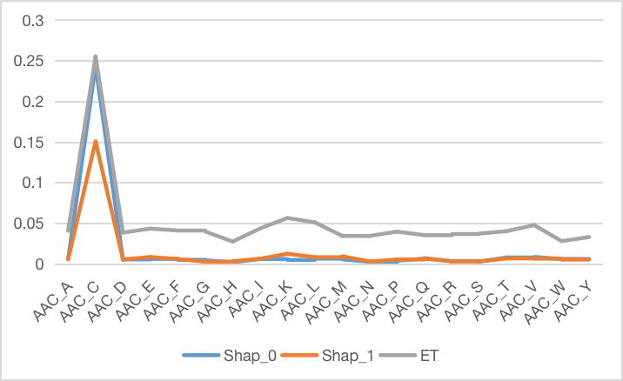
Pearson Correlation Matrix:
 | Shap_0 | Shap_1 | ET
Shap_0 | 1.000000 | 0.997908 | 0.991167
Shap_1 | 0.997908 | 1.000000 | 0.993679
ET | 0.991167 | 0.993679 | 1.000000

Slide 9
SHAP (SHapley Additive exPlanations)
It is based on game theory
It assigns an importance value to each feature in a model
Features with positive SHAP values positively impact the prediction
Negative values have a negative impact
Magnitude is a measure of how strong the effect is.
Setting Shap Explainer:
explainer = shap.Explainer(clf)
shap_values = explainer.shap_values(X_test)

Slide 10
Properties of SHAP Values
Additivity
Contribution of each feature to the final prediction can be computed independently and then summed up
Local accuracy
SHAP values add up to the difference between the expected model output and the actual output for a given input
Missingness
SHAP values are zero for missing or irrelevant features for a prediction
Consistency
SHAP values do not change when the model changes unless the contribution of a feature changes.

Slide 11
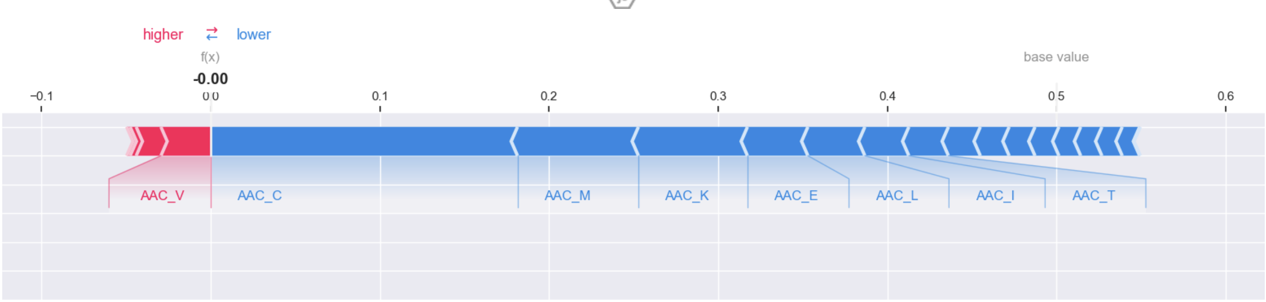
Force Plot
We examine the first sample in the testing set to determine which features contributed to the “1” (toxic) result.
# Create a force plot
# Replace 'instance_index' with the index of the instance you want to explain
instance_index = 1
shap.force_plot(
explainer.expected_value[1], # The expected value of the model output
shap_values[1][instance_index,:], # The SHAP values for the instance
feature_names=x_test.columns, # The feature names
matplotlib=True
)
We can clearly see that AAC_V have contributed to negative to Toxicity.

Slide 12
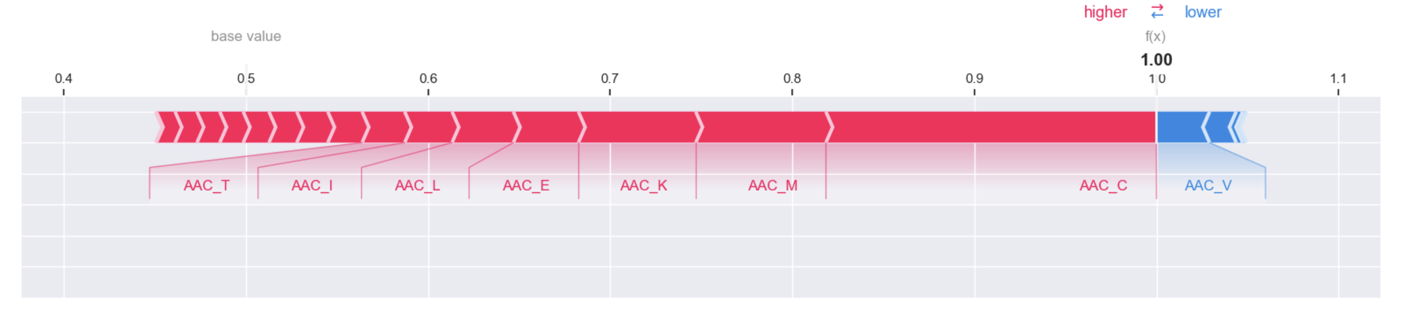
Force Plot
We examine the first sample in the testing set to determine which features contributed to the “0” (non-toxic) result.
# Create a force plot
# Replace 'instance_index' with the index of the instance you want to explain
instance_index = 1
shap.force_plot(
explainer.expected_value[1], # The expected value of the model output
shap_values[1][instance_index,:], # The SHAP values for the instance
feature_names=x_test.columns, # The feature names
matplotlib=True
)

Slide 13
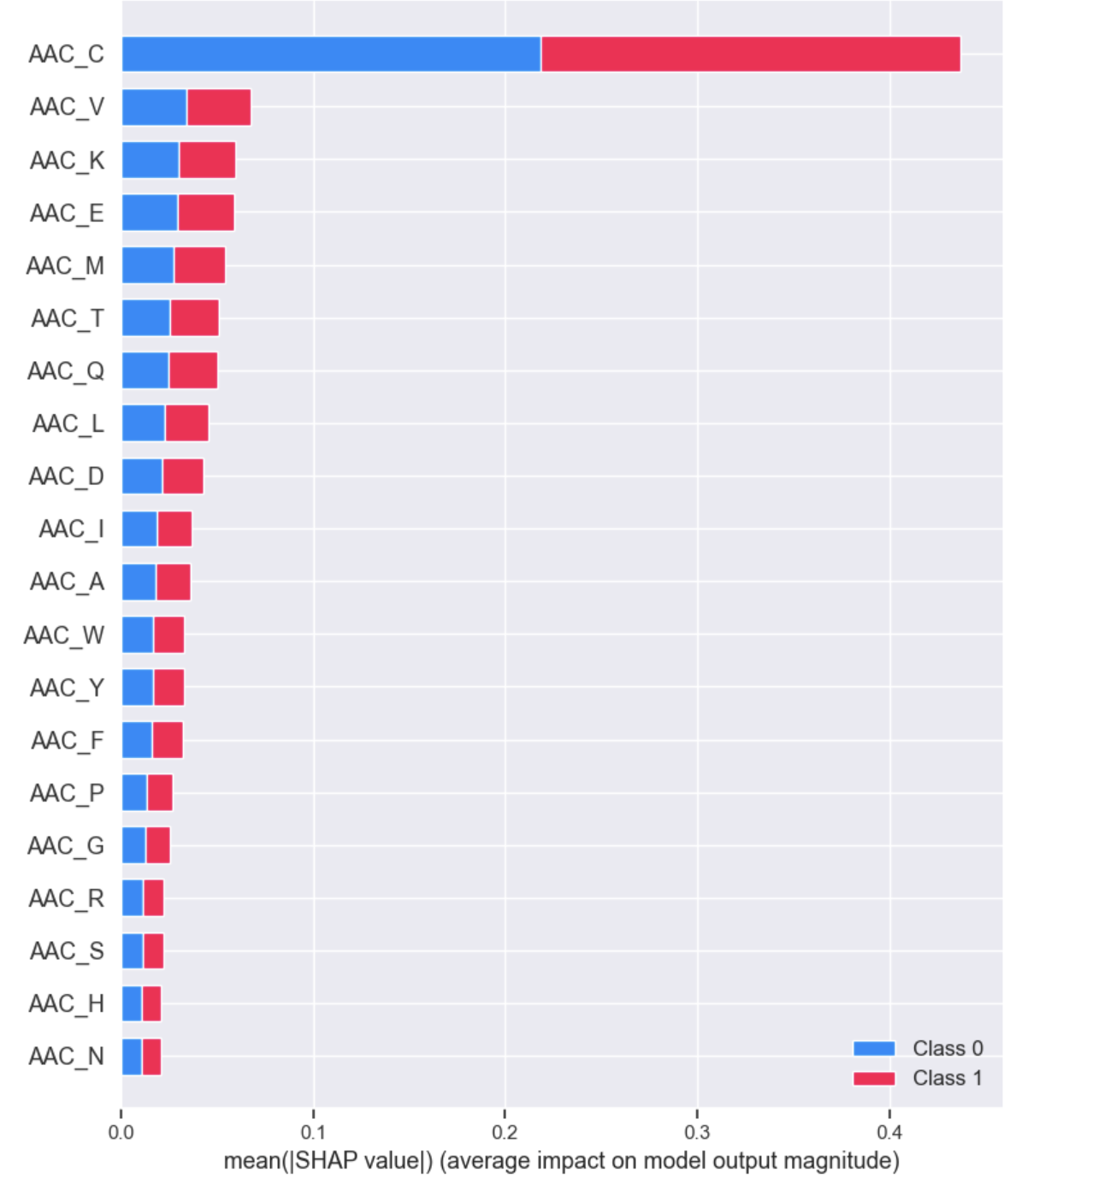
Summary Plot
Display the summary_plot using SHAP values and testing set.
# Create the SHAP summary plot
shap.summary_plot(shap_values, x_test, feature_names=top_x_train.columns)
The summary plot shows the feature importance of each feature in the model.
The results show that “AAC_C,” “AAC_V,” “AAC_E,” and “AAC_K” play major roles in determining the results.

Slide 14
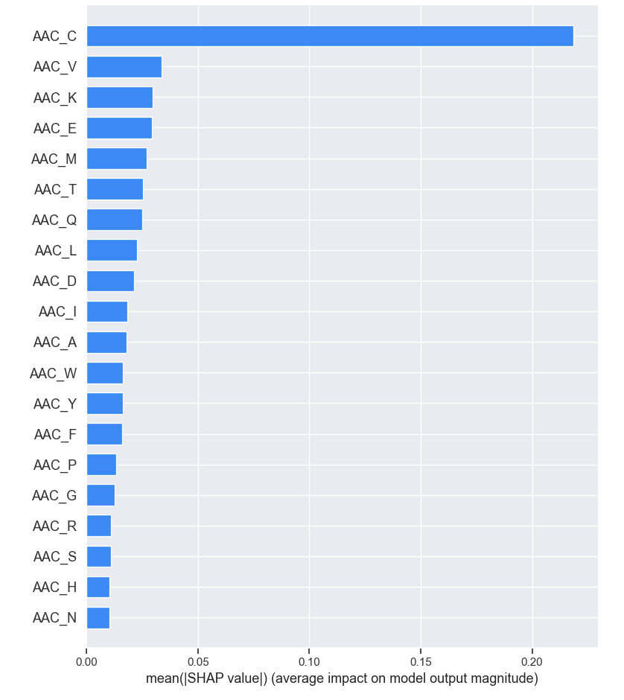
Summary Plot
Display the summary_plot using SHAP values and testing set.
# Create the SHAP summary plot
shap.summary_plot(shap_values, x_test, feature_names=top_x_train.columns)
The summary plot shows the feature importance of each feature in the model.
The results show that “AAC_C,” “AAC_V,” “AAC_E,” and “AAC_K” play major roles in determining the results.

Slide 15
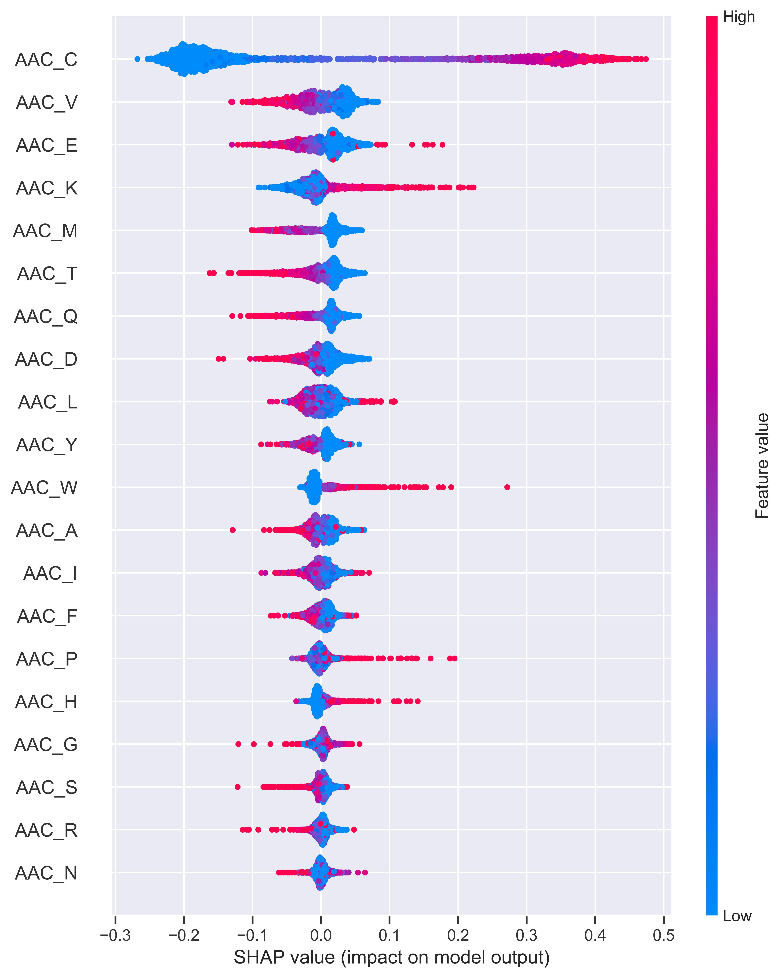
summary_plot of the label “1”
Y-axis: feature names in order of importance from top to bottom.
X-axis: SHAP value, which indicates the degree of change in log odds.
The color of each point on the graph represents the value of the corresponding feature, with red indicating high values and blue indicating low values.
Each point represents a row of data from the original dataset.
If you look at the feature “AAC_C ', you will see when value is low with a negative SHAP value. It means lower AAC_C counts tend to negatively affect the output.
In contrast If you look at the feature “AAC_V ', ', you will see when value is high with a negative SHAP value. It means higher AAC_V counts tend to negatively affect the output.

Slide 16
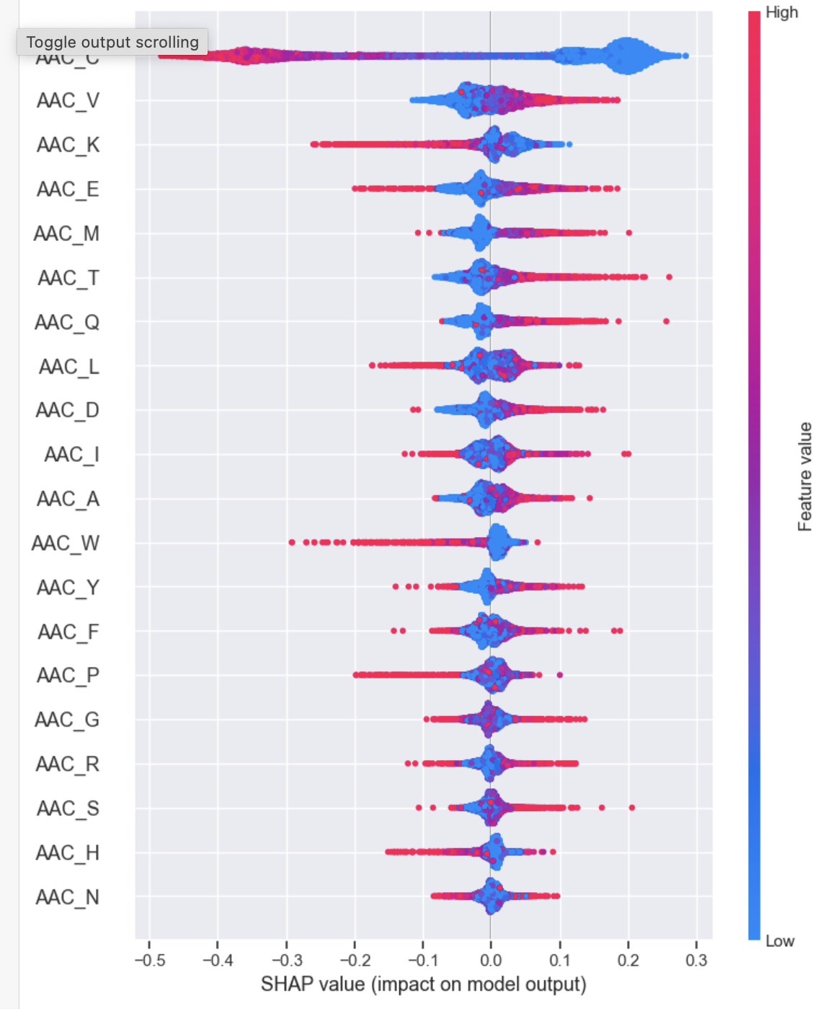
summary_plot of the label “0”
Y-axis: feature names in order of importance from top to bottom.
X-axis: SHAP value, which indicates the degree of change in log odds.
The color of each point on the graph represents the value of the corresponding feature, with red indicating high values and blue indicating low values.
Each point represents a row of data from the original dataset.
If you look at the feature “AAC_C ', you will see when value is high with a negative SHAP value. It means higher AAC_C counts tend to negatively affect the output.
In contrast If you look at the feature “AAC_V ', ', you will see when value is low with a negative SHAP value. It means higher AAC_V counts tend to positively affect the output.

Slide 17
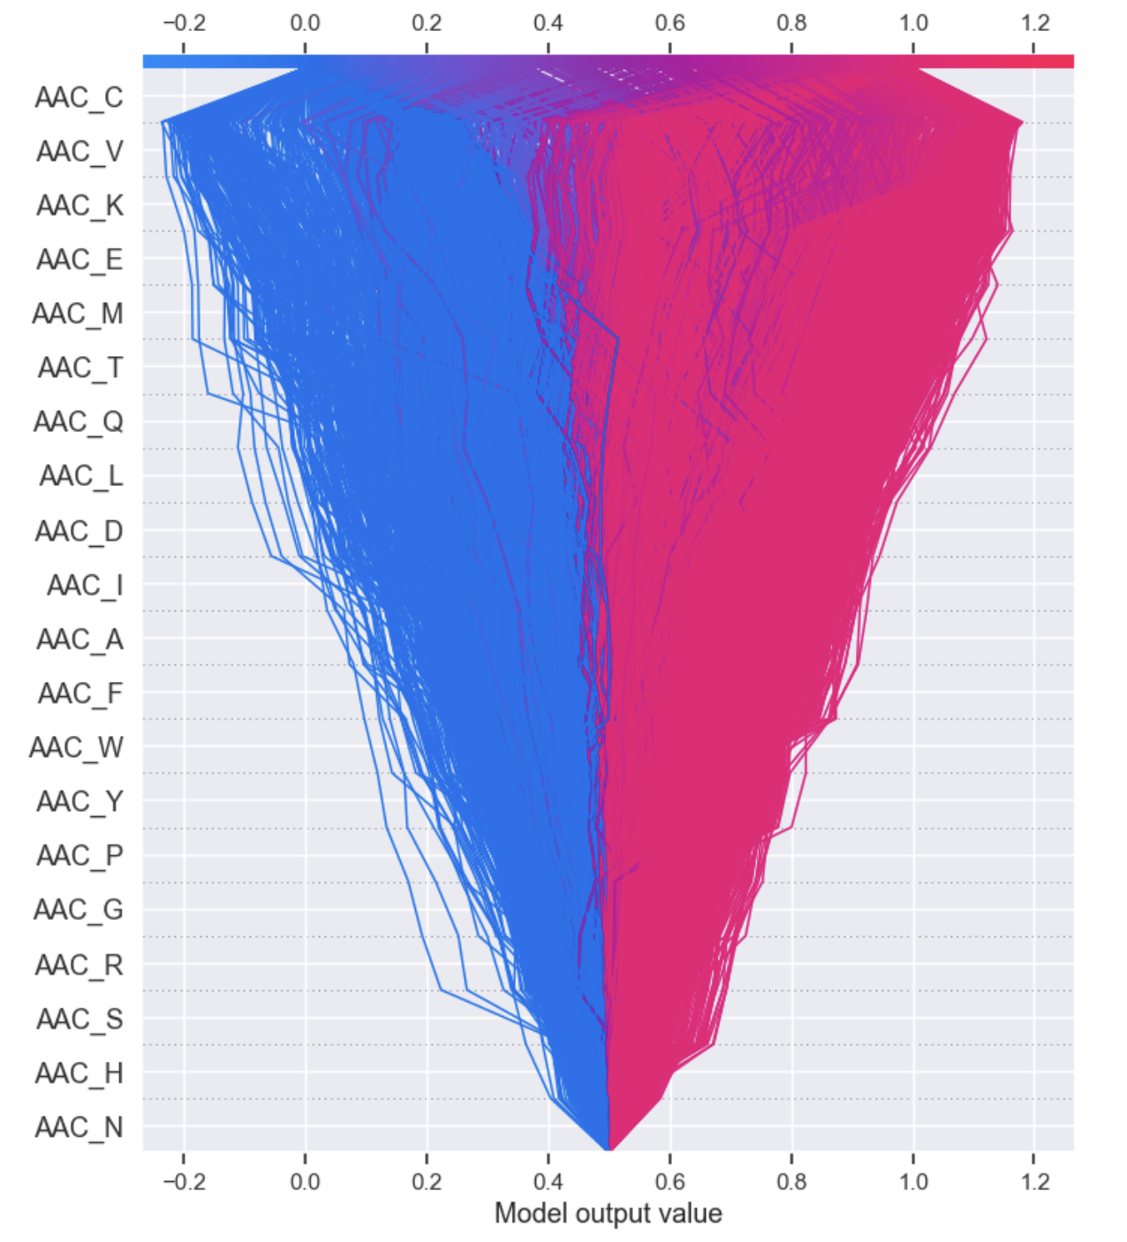
Decision Plot
It visually depicts the model decisions by mapping the cumulative SHAP values for each prediction.
shap.decision_plot(explainer.expected_value[1], shap_values[1],
Each plotted line on the decision plot shows how strongly the individual features contributed to a single model prediction, thus explaining what feature values pushed the prediction.

Slide 18
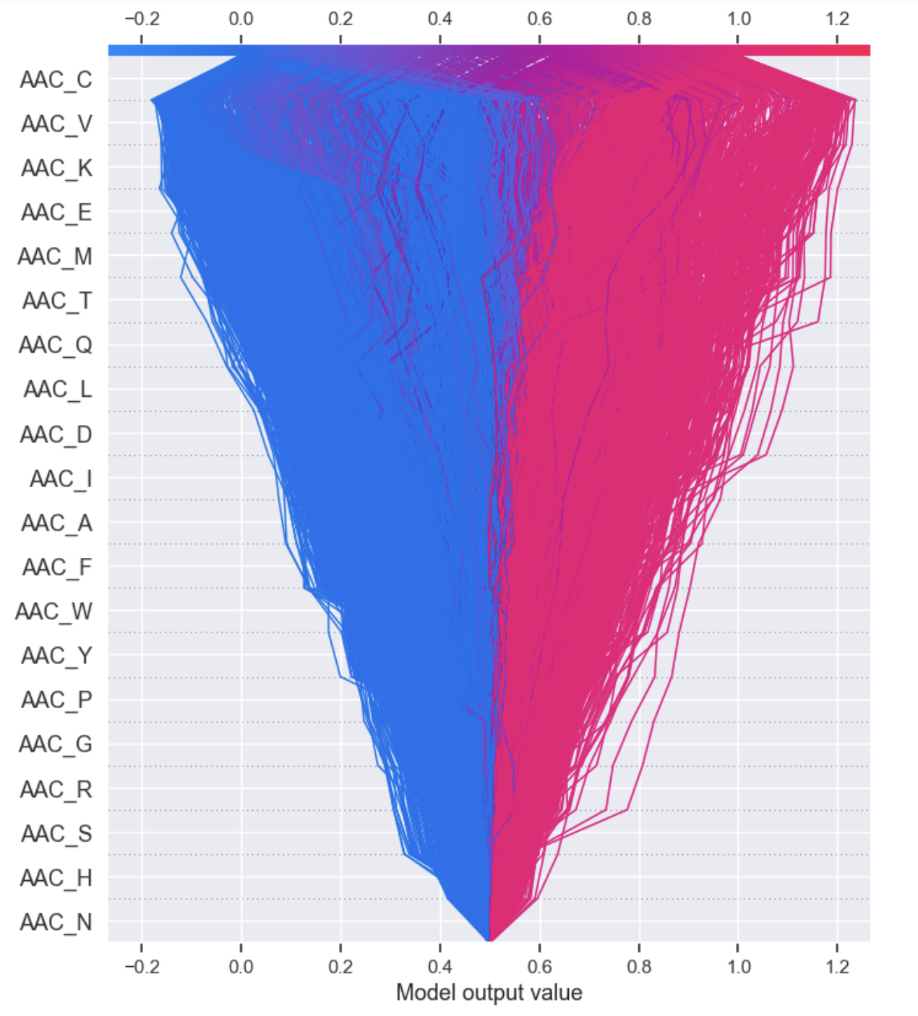
Decision Plot
It visually depicts the model decisions by mapping the cumulative SHAP values for each prediction.
shap.decision_plot(explainer.expected_value[0], shap_values[0],
Each plotted line on the decision plot shows how strongly the individual features contributed to a single model prediction, thus explaining what feature values pushed the prediction.

Slide 19
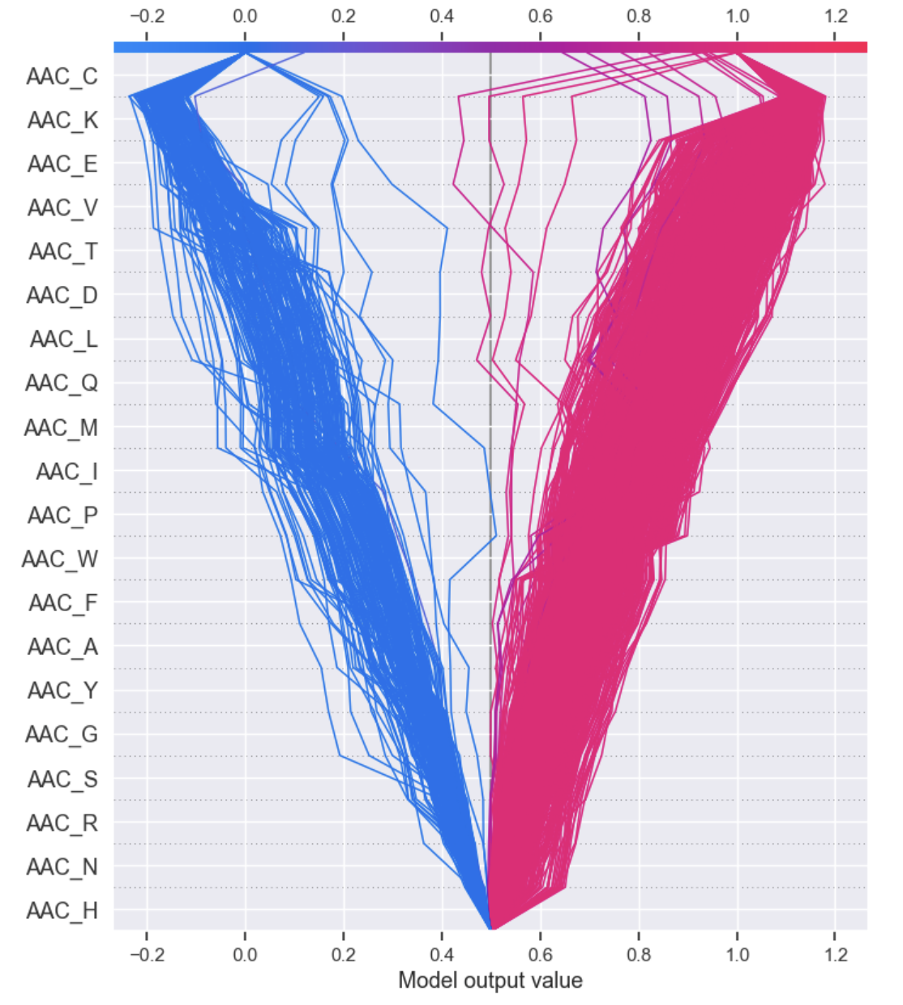
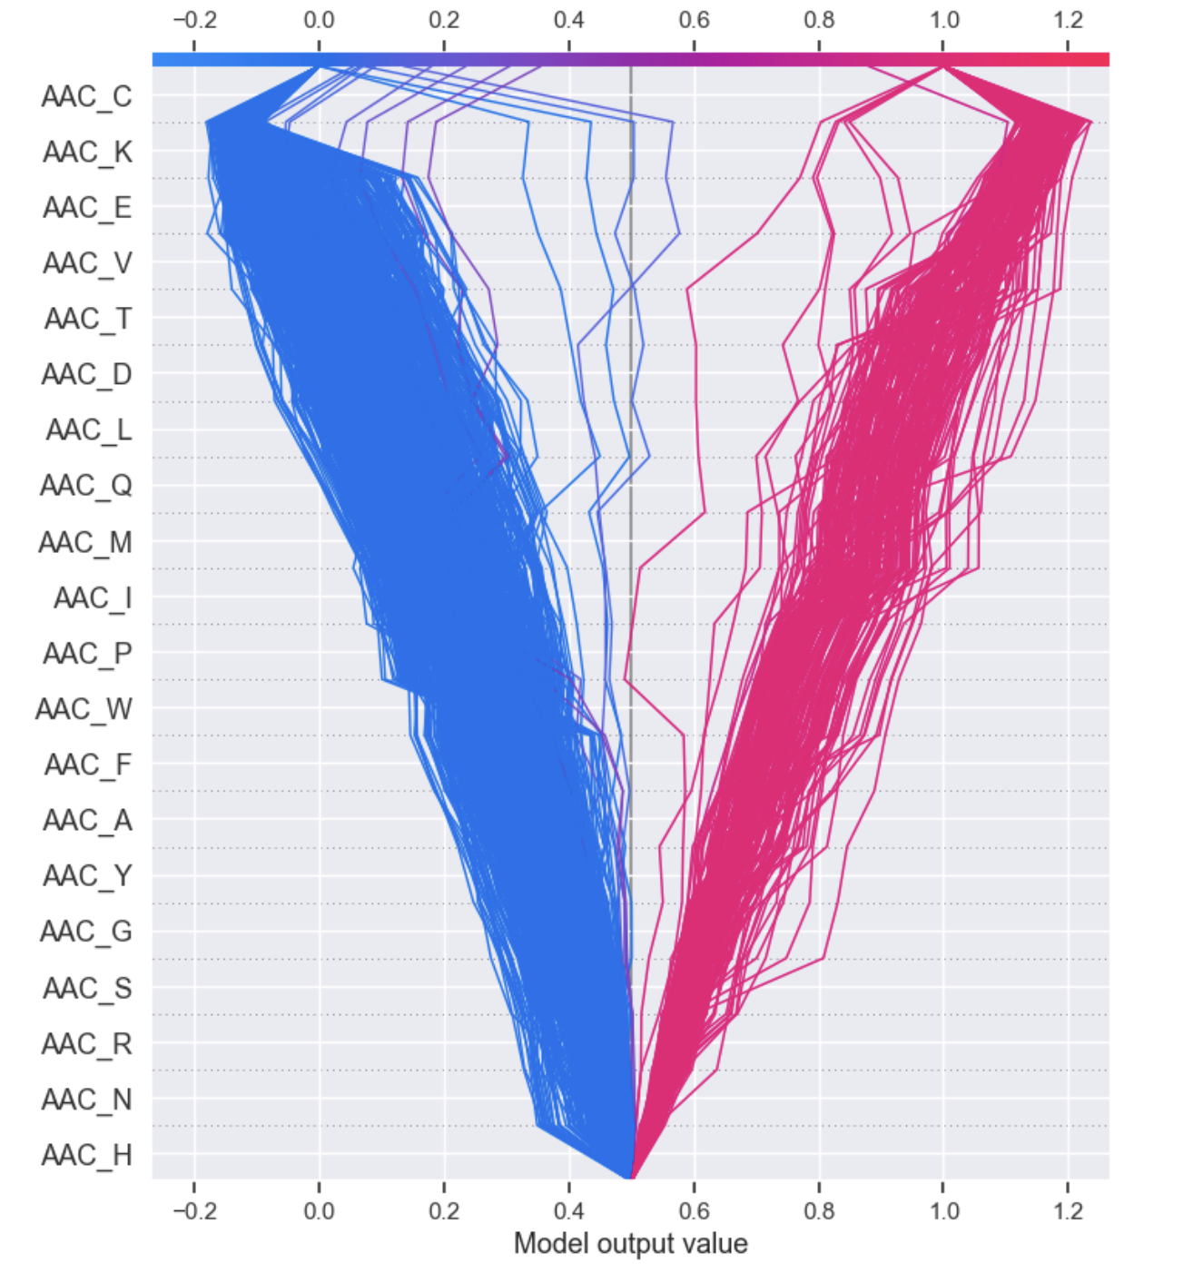
Target label ‘1’
Target label ‘0’

Slide 20
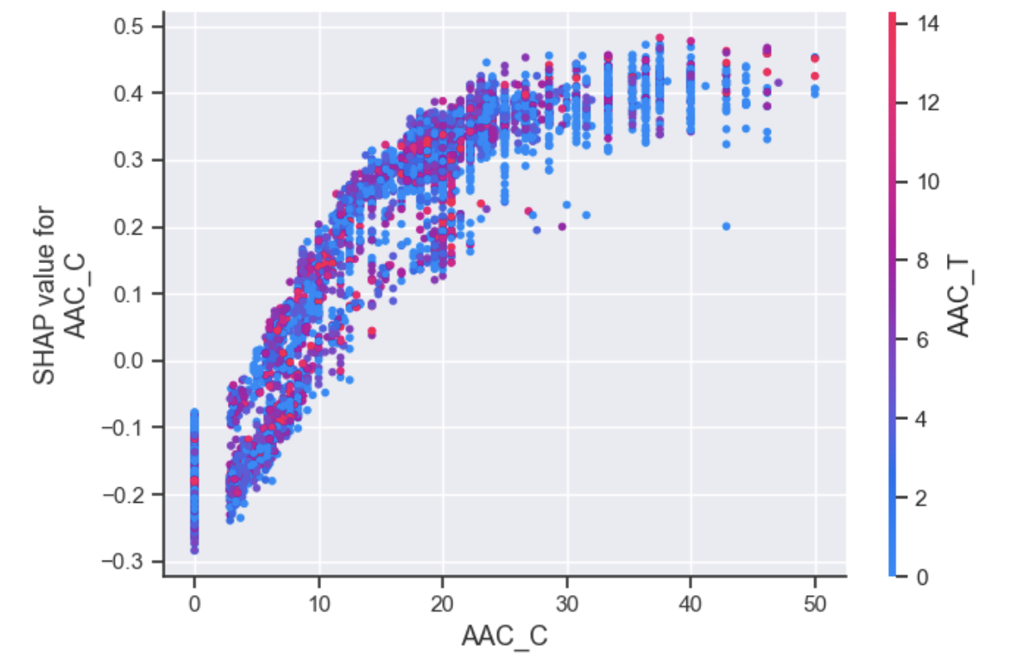
Dependence plot

Slide 21
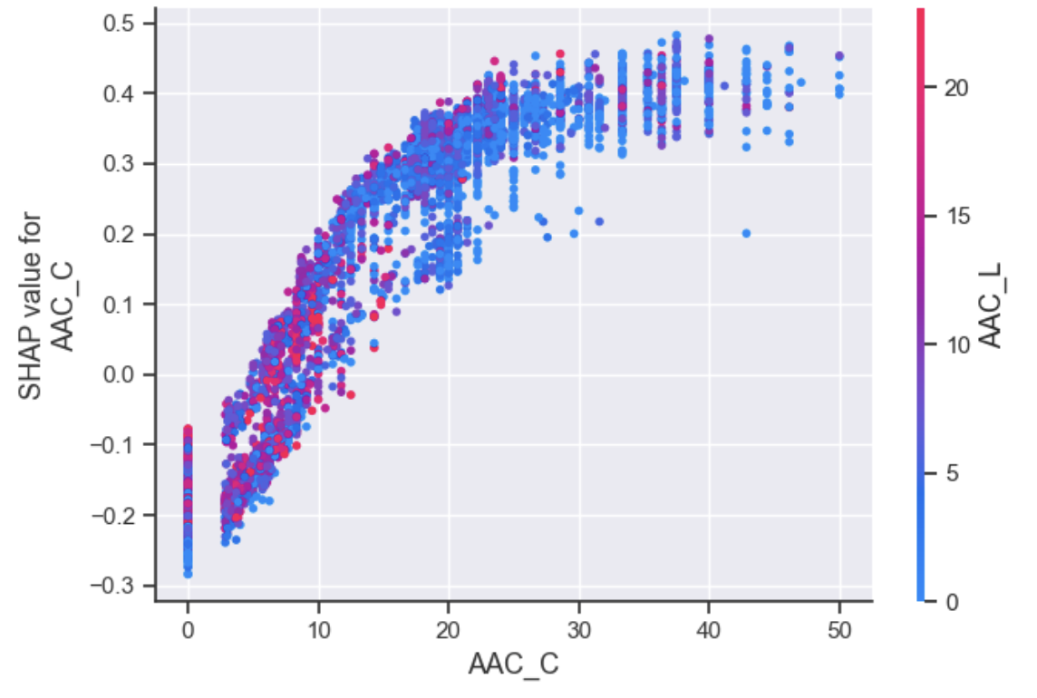
Dependence plot

